Slide 1
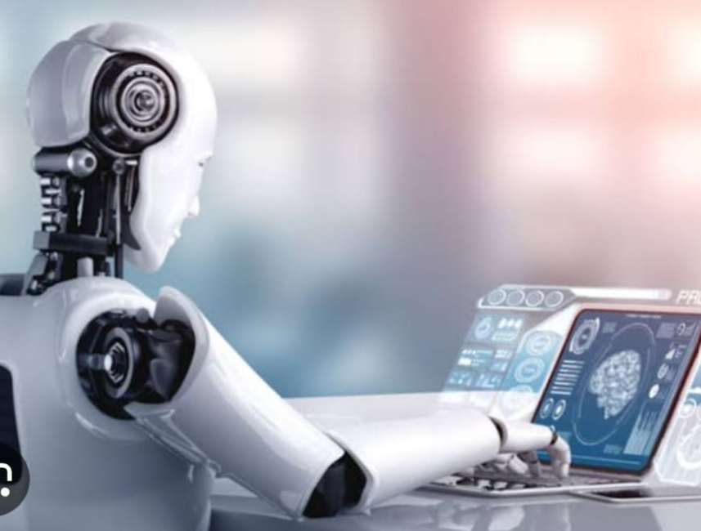
ARTIFICIAL INTELLIGENCE

Slide 2
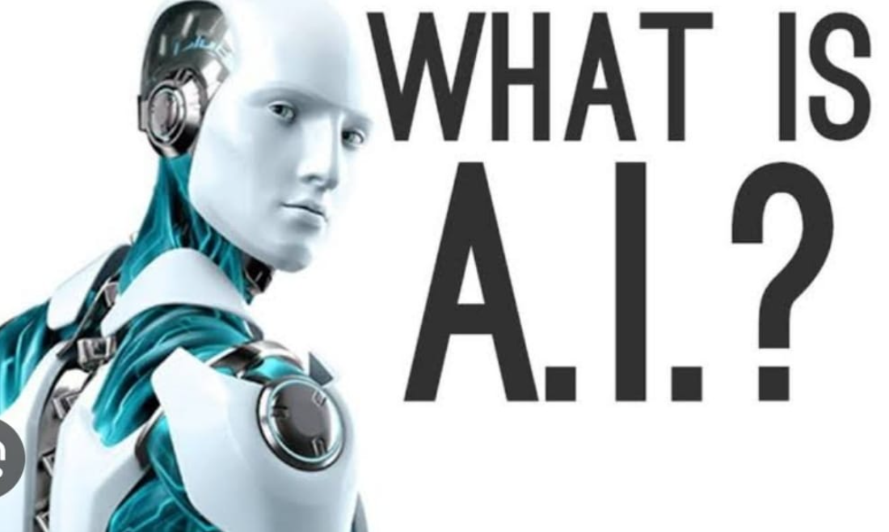
INTRODUCTION:
Artificial intelligence is a branch of science which deals with helping machines finds solutions to complex problems in a more human-like fashion.
This generally involves borrowing characteristics from human intelligence, and applying them as algorithms in a computer friendly way.

Slide 3
Brief History of AI:
1941:First electronic computer(technology finally available)
1956:Term Artificial Intelligence introduced
1960s:Checkers-playing program that was able to play games with opponents.
1980s:Quality Control Systems
2000: First sophisticated walking robot

Slide 4
WHY AI?
Computers are fundamentally well suited to performing mechanical computations, using fixed programmed rules. This allows artificial machines to perform simple monotonous tasks efficiently and reliably, which humans are ill-suited to.

Slide 5
APPLICATIONS OF AI:
Expert systems
Natural Language Processing(NLP)
Speech recognition
Computer vision
Robotics

Slide 6
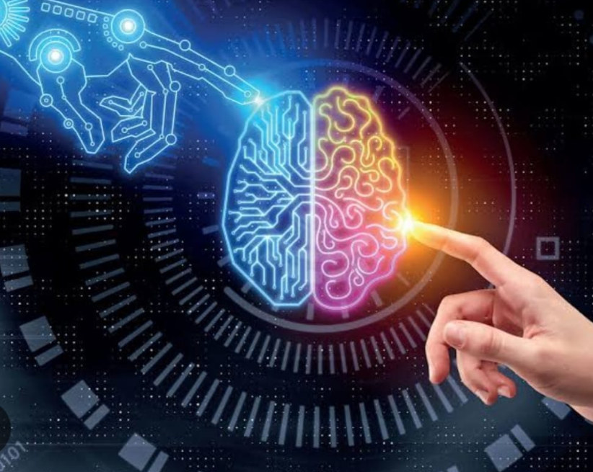
CURRENT STATUS OF AI:
AI has taken many shapes and forms over recent years
Mobile phones(Siri/Cortana)
Video games characters
GPS/Voice recognition
Robotics
Google has been a major play on AI transcendence and deep learning.

Slide 7
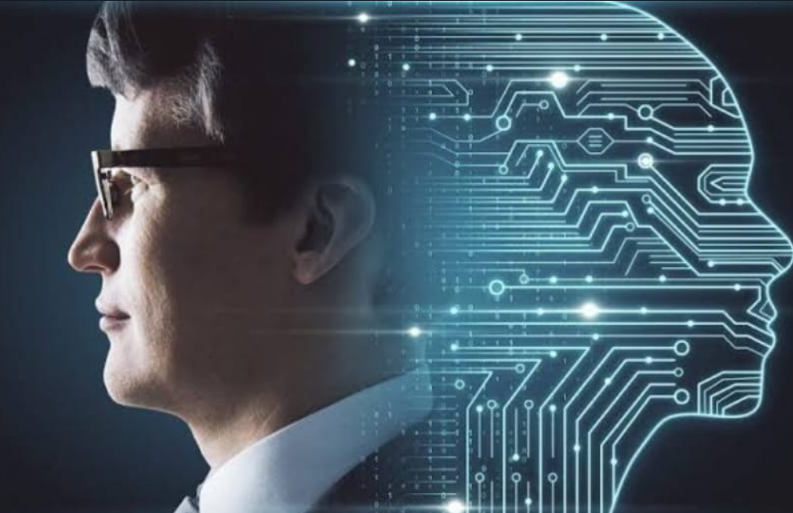
FUTURE OF AI:
Beyond negotiation, Moore says CMU is betting several other AI areas are going to be hugely important in the near future.
Self Driving Cars
Improved Medical Care and treatment
Open up doors to future explorations
Etc.

Slide 8
CHALLENGES:
Computing Power
Tolerance Power
Intuitive Thinking
Judging Power

Slide 9
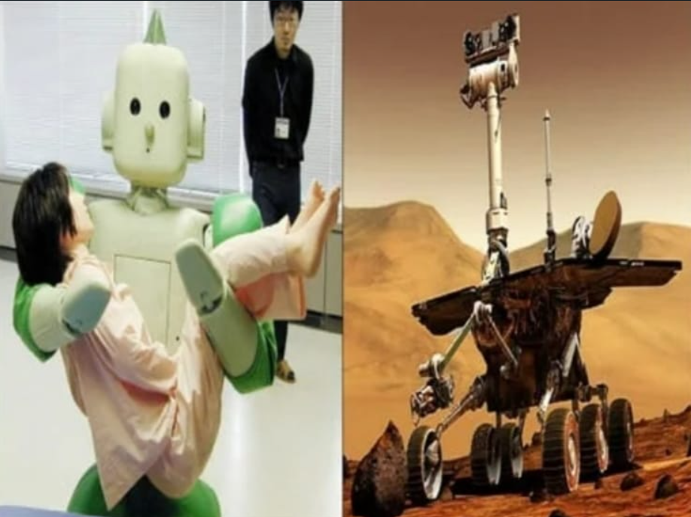
Advantages:
They will probably ne increasingly used in the field of medicine.
A knowledge based expert system, which can cross-reference symptoms and diseases will greatly improve the accuracy of diagnostics.
Object recognition will also be a great aid to doctors.
Along with images from cats cans or X-ray machines, they will be able to get preliminary analysis of those images.

Slide 10
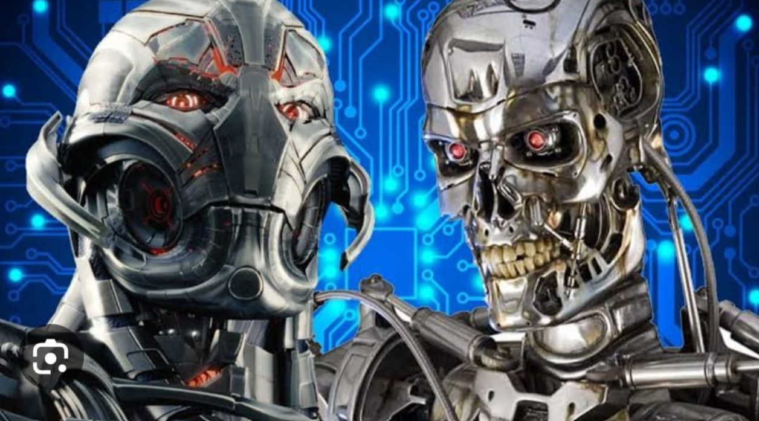
DISADVANTAGES:
Self-modifying, when combined with self-replicating, can lead to dangerous ,unexpected results, such as a new and frequently mutating computer virus.
No improvement with experience.

Slide 11
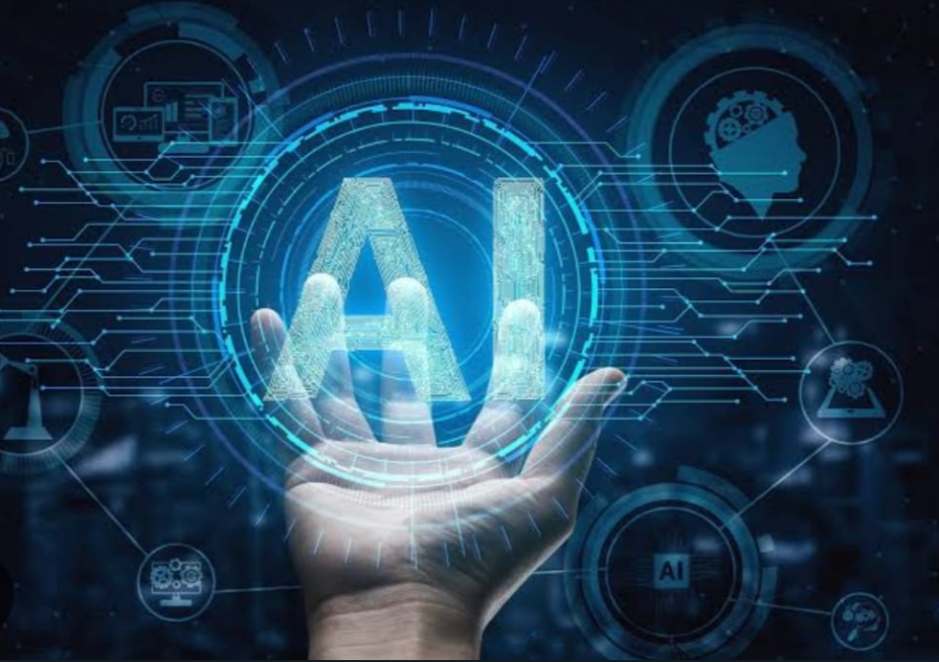
CONCLUSION:
In its short existence, AI has increased understanding of the nature of intelligence and provided an impressive array of application in a wide range of areas . It has sharpened understanding of human reasoning, and of the nature of intelligence in general. At the same time, it has revealed the complexity of modeling human reasoning providing new areas and rich challenges for the future.

Slide 12
THANK YOU

